Slide 1

COSI 104a Introduction to machine learning
Chapter X – Data Centric Learning
 | Instructor: Dr. Hongfu Liu Email: hongfuliu@brandeis.edu

Slide 2
Data Visualization
Tools
Bar, scatter plot, line, histograms, pie, box plots, bubble chart
2D plot, not 3D
Check samples or features
The key is to understand the intrinsic structure or the predictive power (linear or non-linear correlation).
https://www.youtube.com/watch?v=csXmVBw8cdo

Slide 3
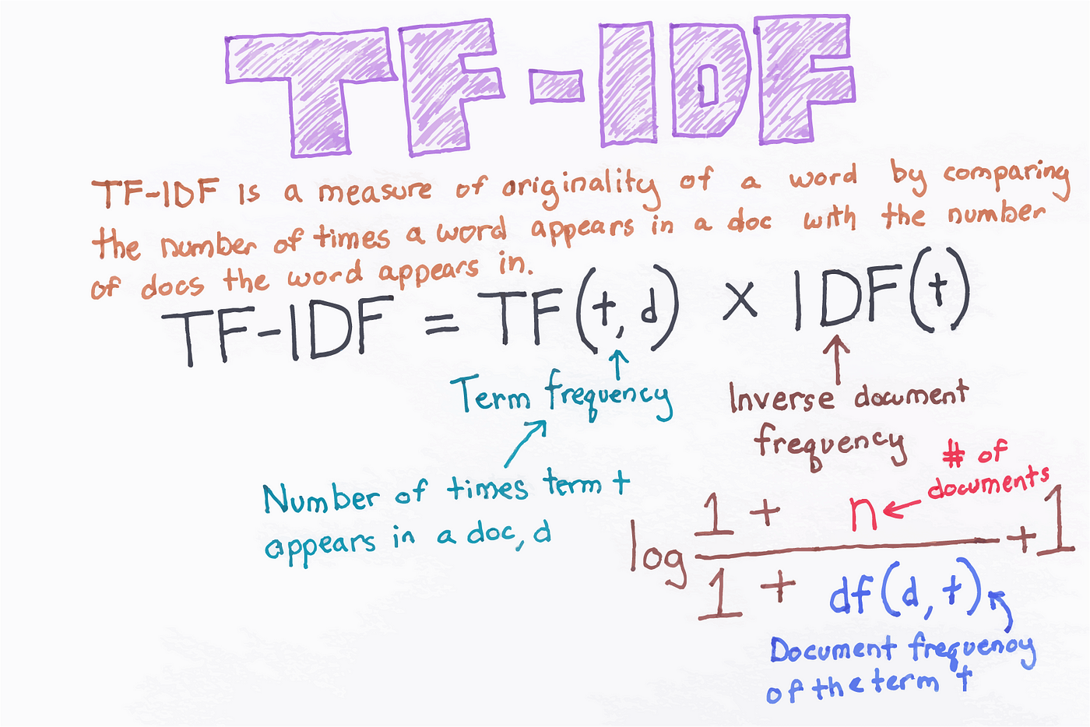
Normalization
Attribute Type
Zero-mean
Min-max
TF-IDF
When to normalize?
https://medium.com/analytics-vidhya/demonstrating-calculation-of-tf-idf-from-sklearn-4f9526e7e78b

Slide 4
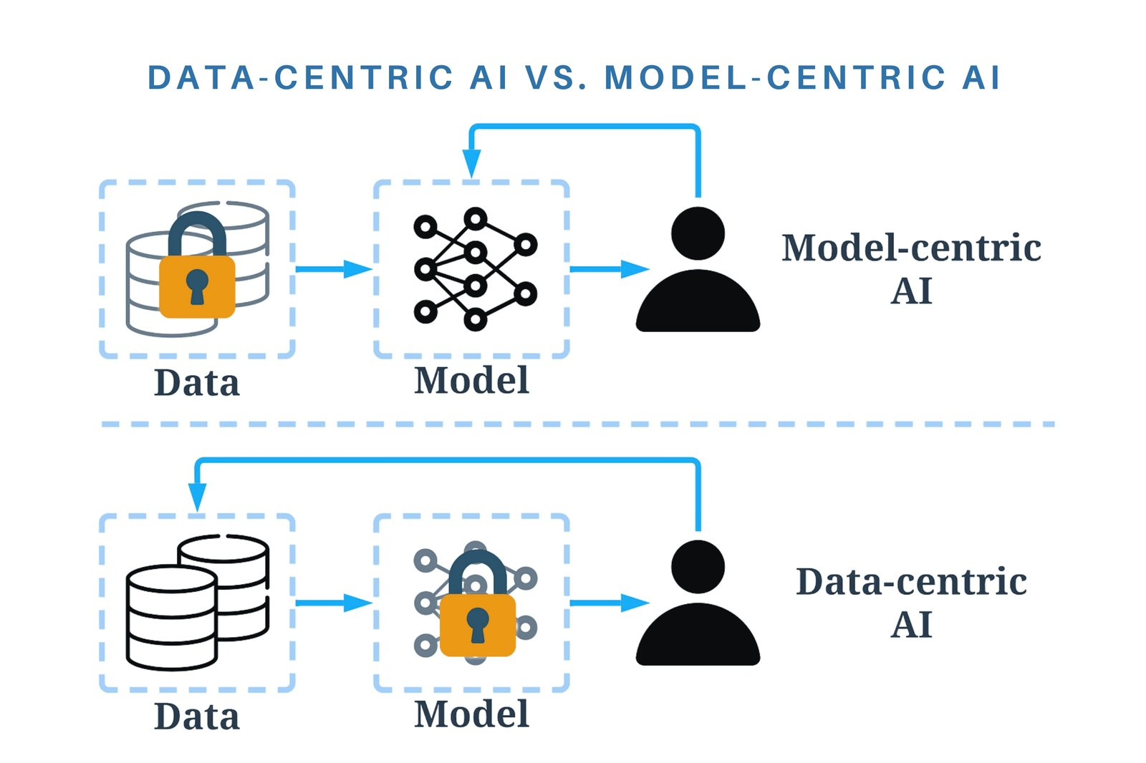
Data-Centric Learning
One man's trash is another man's treasure
The assessment of data valuation cannot be isolated from the overarching goal.
Some techniques that also focus on data, including outlier detection, data augmentation and so on, do not belong to data-centric learning.

Slide 5
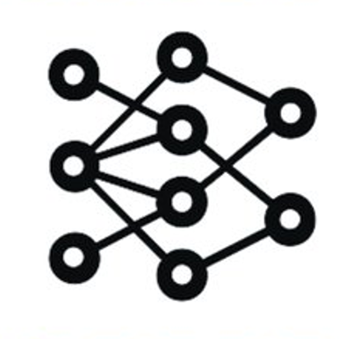
Data-Centric Learning
The fundamental question in data-centric learning is how to assess the data valuation.
One naïve way is the famous leave-one-out influence.
We measure the performance change on the validation set with one data sample removed from the training set.
Training Set
Model
Training Set
Model

Slide 6
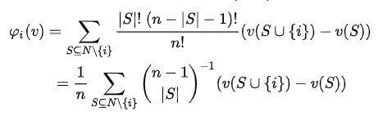
Shapley - Sample

Slide 7
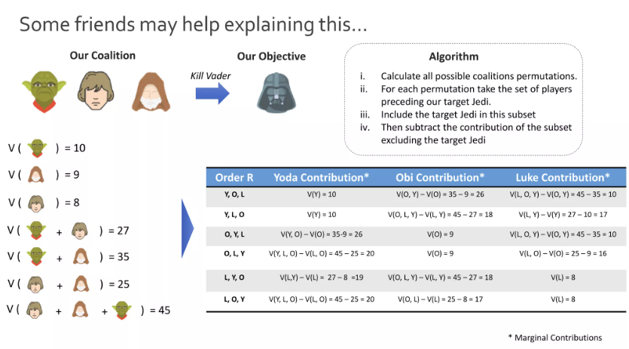
Shapley - Sample
https://www.slideshare.net/slideshow/shap-144149270/144149270#19

Slide 8
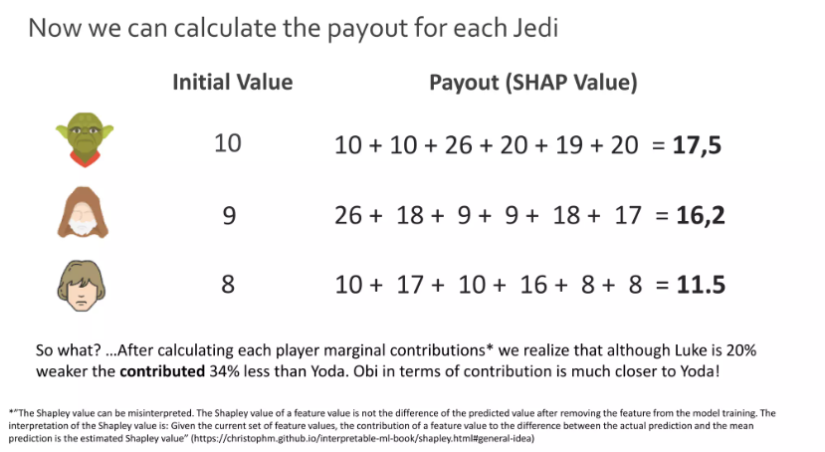
Shapley - Sample

Slide 9

Shapley - Sample
KNN-Shapley
https://pydvl.org/stable/examples/shapley_knn_flowers/#building-a-dataset-and-a-utility

Slide 10
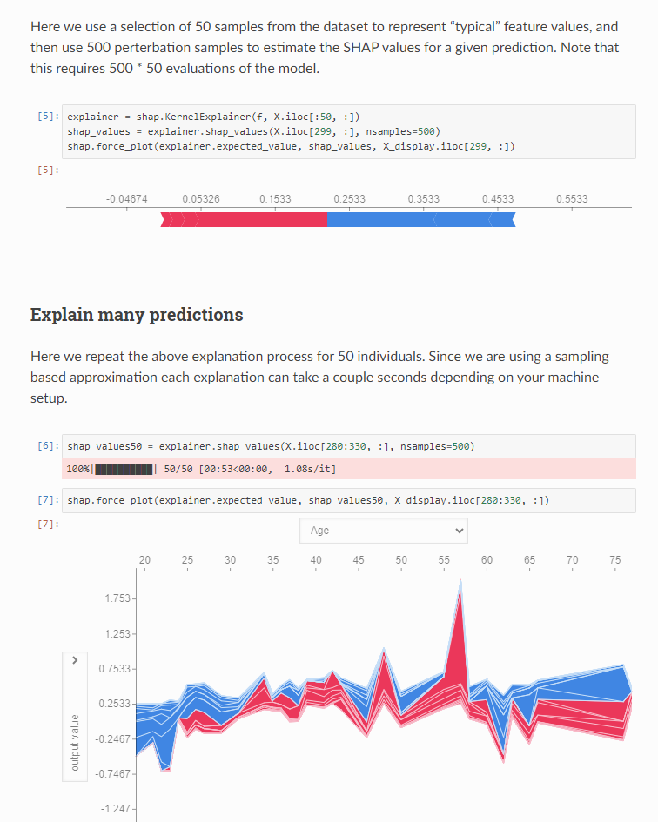
Shapley - Feature
https://shap.readthedocs.io/en/latest/

Slide 11


